Slide 1
CPSC 326 Project 2
Myanna Harris and Kristina Spring

Slide 2
F#
Developed by the F# Software Foundation, Microsoft and open contributors.
F# originated as .NET implementation of a core of the OCaml programming language
Encompasses functional, imperative, and object-oriented programming techniques
Notes:
https://en.wikipedia.org/wiki/F_Sharp_%28programming_language%29

Slide 3
F# - Impressions
The variables are interesting because their types can be set implicitly
Variables are immutable unless specifically noted as mutable
The compiler is very slow

Slide 4
F# - Features
Strongly typed
Can be used to generate JavaScript and GPU code
Multi-paradigm language:
Functional programming
Object oriented programming
Language oriented programming
Notes:
http://tomasp.net/articles/fsharp-i-introduction/article.pdf

Slide 5
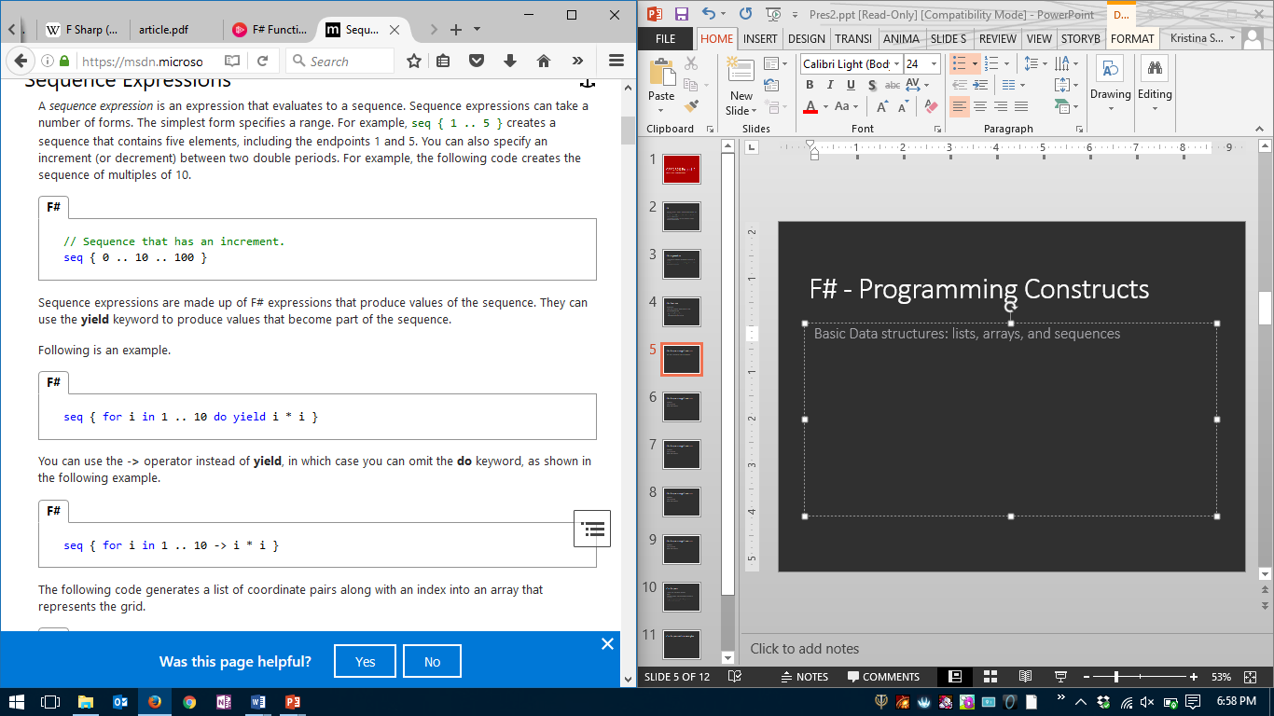
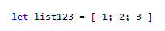
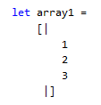
F# - Programming Constructs
Basic Data structures: lists, arrays, and sequences
Notes:
https://msdn.microsoft.com/en-us/library/dd233209.aspx
https://msdn.microsoft.com/en-us/library/dd233214.aspx

Slide 6
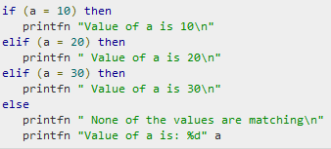
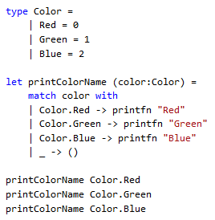
F# - Programming Constructs
Selection statements: if, pattern matching
Notes:
http://www.tutorialspoint.com/fsharp/fsharp_if_elif_else_statement.htm

Slide 7
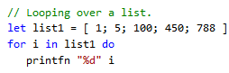
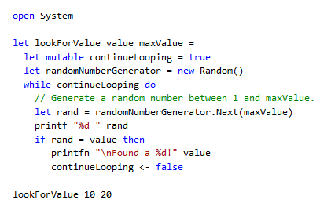
F# - Programming Constructs
Repetition constructs: fixed count loops, variable count loops

Slide 8
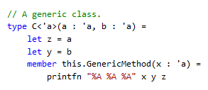
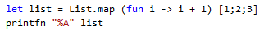
F# - Programming Constructs
Objects, Classes, and Inheritance: generic classes, anonymous functions (lambda expressions)

Slide 9
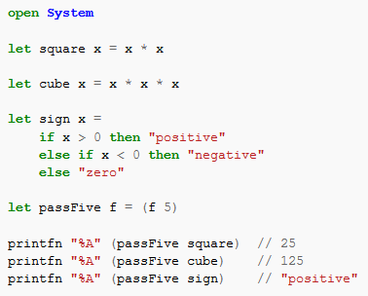
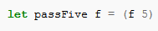
F# - Programming Constructs
Objects, Classes, and Inheritance: higher order functions
Notes:
https://en.wikibooks.org/wiki/F_Sharp_Programming/Higher_Order_Functions

Slide 10
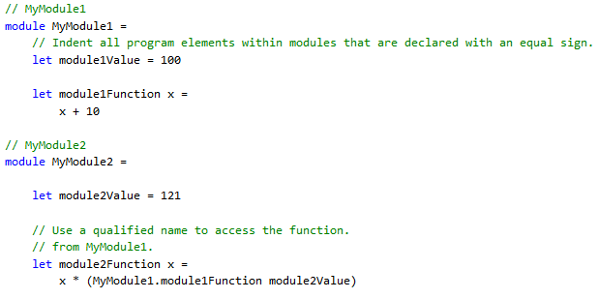
F# - Programming Constructs
Modules

Slide 11
Our Program
Environmental Sustainability Calculator
Text UI
Takes user’s answers and calculates their sustainability percentage
A larger percentage means their lifestyle is more environmentally sustainable

Slide 12
Environmental Sustainability Calculator
Highlights of the design

Slide 13
Basic Data Structure - Array

Slide 14
Selection Statements – If & Pattern Matching

Slide 15
Repetition Construct

Slide 16
Classes and Lambda Expressions

Slide 17
Higher Order Function

Slide 18
Modules

Slide 19
Demo

